Slide 1

Columbia Asia hospital Analysis
Saran Arul Yogan A
10/12/2024

Slide 2
About Columbia Asia hospital
Columbia Asia Hospital is a renowned healthcare provider known for its patient-centric approach and world-class medical facilities.
With a strong presence across multiple locations, the hospital offers comprehensive services across various specialties, ensuring high-quality care.
Its focus on innovation, advanced technology, and skilled professionals has established Columbia Asia as a trusted name in the healthcare industry.

Slide 3

Project aim
To evaluate the hospital's revenue generation, identify departments for potential new hires, and propose strategies for patient discounts to enhance efficiency and satisfaction.

Slide 4
Data overview
Patient Race: The racial or ethnic background of the patient is recorded here, with categories such as 'White', 'African American', 'Asian', 'Native American/Alaska Native', and 'Two or More Races'.
Patient Admin Flag: This column contains boolean values ('TRUE' or 'FALSE') which might indicate whether the patient was admitted or some other administrative flag.
Patient Wait Time: Appears to indicate the time the patient waited, possibly in minutes, before being seen or processed.
Department Referral: This column lists the department to which the patient was referred, with entries such as 'General Practice', 'Orthopaedics', 'Gastroenterology', or 'None' indicating no referral.
Doctor Name: Identifies the doctor who attended each patient.
Appointment Fees: The cost charged for a doctor's consultation.
Total Bill: The overall amount billed to the patient, including all services and charges.
Date: This column contains date and time information without specifying AM or PM. The format is DD-MM-YYYY HH:MM.
Patient ID: Each patient is assigned a unique identifier, which seems to be in the format 124-62-3289.
Patient Gender: This column records the gender of the patient, denoted by 'M' for male and 'F' for female.
Patient Age: The age of the patients is listed in years.
Patient Sat Score: It seems to represent a satisfaction score given by or for the patient. However, the scores are single-digit, and it's not clear what the scale is.
Patient First Initial: This column contains the first initial of the patient's first name.
Patient Last Name: The surname of the patient is listed in this column.

Slide 5

methodology
Data Loading and Transformation: Loaded data into Power BI, transformed it using Power Query, and performed data cleaning to ensure consistency and accuracy.
Measure Creation: Developed numerous measures using DAX functions, including calculated columns, filters, aggregation functions (SUMX), and time intelligence calculations.
Visualization Creation: Designed various visuals such as bar charts, column charts, cards, gauges, and pie charts to effectively present insights.
Dashboard and Interaction: Utilized features like edit interactions, slicers, and drill-throughs to create an interactive dashboard and comprehensive report.

Slide 6

Data cleaning process
Replaced null values in the Satisfaction Score column with the mean to ensure accurate analysis.
Created a Calendar Table from the date column and built a relationship model for time-based analysis.
Checked for null values across the dataset to identify and address data gaps.
Verified data types for consistency and ensured there were no errors in the columns.
Performed all cleaning tasks in Power Query, then applied the changes using the Close & Apply feature.

Slide 7
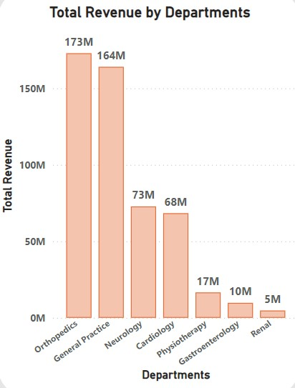
Total revenue by department
The Orthopedics Department recorded the highest total revenue among all departments, generating 173 million.
The Renal Department had the lowest total revenue, contributing just 5 million.

Slide 8
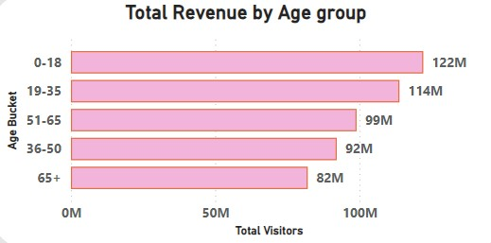
Total revenue by age group
The age group 0-18 generated the highest revenue, totaling 122 million, followed by the 19-35 age group with 114 million.
The lowest revenue was recorded in the 65+ age group, contributing 82 million.

Slide 9
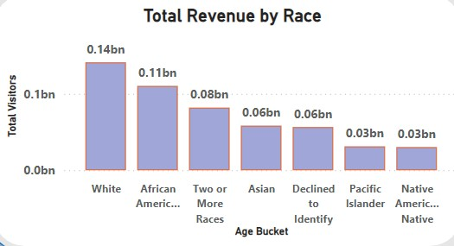
Total revenue by race
The White demographic generated the highest revenue, contributing 0.14 billion to the government, followed by African Americans with 0.11 billion.
The Native American demographic recorded the lowest revenue, contributing 0.03 billion.

Slide 10
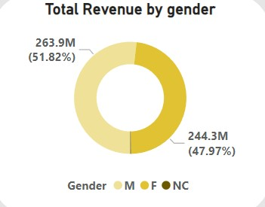
Total revenue by gender
Males generated the highest revenue, contributing 263.9 million (51.82%), followed by Females with 244.3 million (47.97%).
The NC (Not Categorized) category contributed the remaining 1 million.

Slide 11
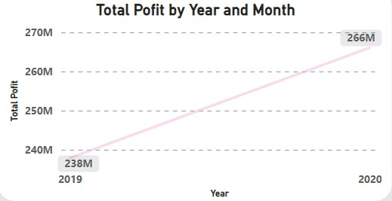
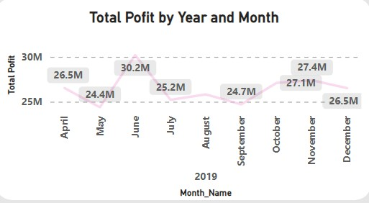
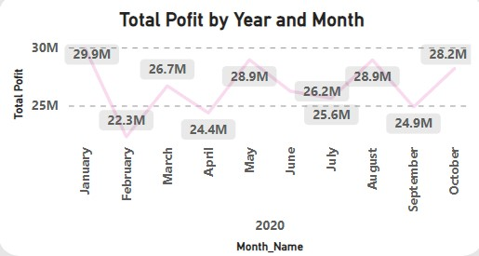
Total profit by year
In 2019, the total profit was 238 million, with the peak profit recorded in June at 30.2 million.
In 2020, the total profit increased to 266 million, with the highest profit in January at 29.9 million.

Slide 12
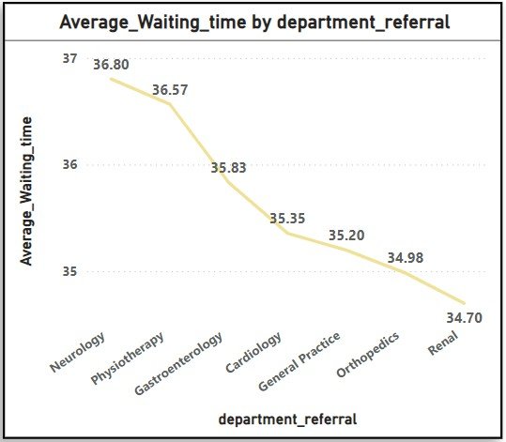
Department-Wise Average Waiting Time
The Neurology Department has the highest average waiting time of 36.80 minutes, followed closely by Physiotherapy with 36.57 minutes.
The Renal Department has the lowest average waiting time of 34.70 minutes.

Slide 13
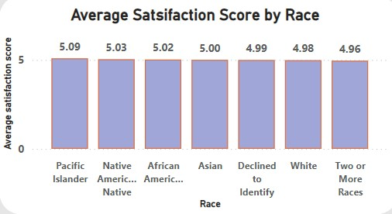
Race-Wise Average Satisfaction Score:
The highest average satisfaction score is among Pacific Islanders at 5.9, followed by Native Americans at 5.03.
The lowest average satisfaction score is 4.96.

Slide 14
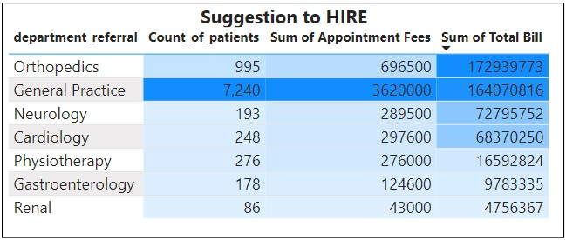
Suggestions for Hiring
General Practice: With the highest demand of 7,240 patients, 3.62M in appointment fees, and 164.07M total bill, this department is the primary choice for new hires.
Orthopedics: If General Practice is not prioritized, the next best option is Orthopedics, with 995 patients, 696.5K in appointment fees, and 172.94M total bill, indicating strong revenue potential.

Slide 15
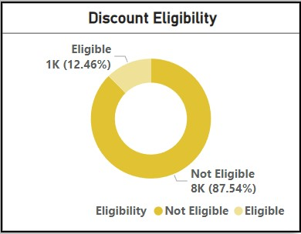
Discount Eligibility Analysis
Out of 9,216 patients, 12.46% are eligible for a discount, based on spending over 10,000 and a satisfaction score above 6.
The remaining 87.54% of patients are not eligible for the discount.

Slide 16
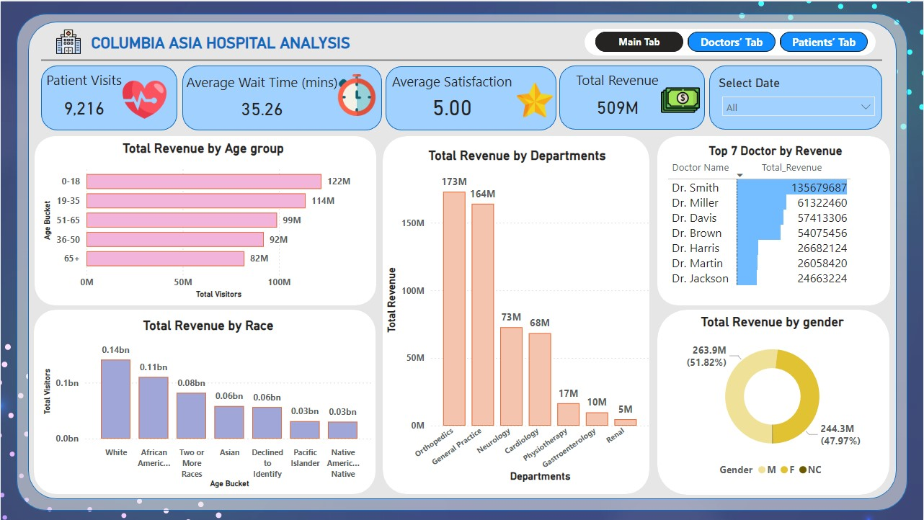
Main tab

Slide 17
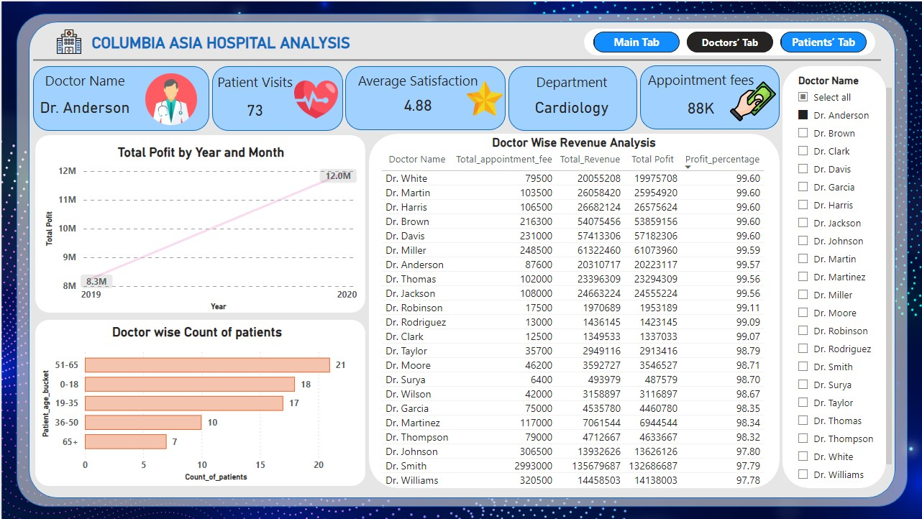
Doctor's tab

Slide 18
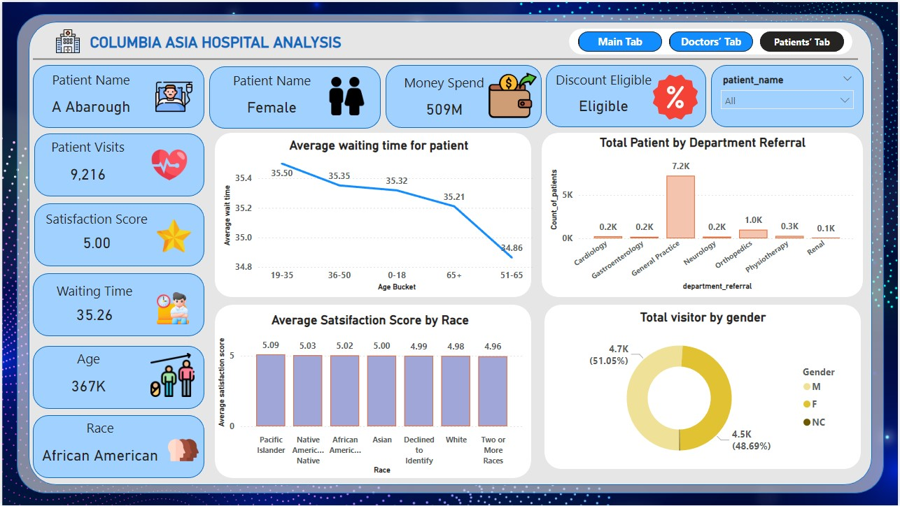
patient's tab

Slide 19
Key Recommendations Based on Columbia Asia Hospital Analysis
Orthopedics Department: The Orthopedics Department generated the highest revenue at 173 million, making it a key area for continued focus and investment.
Renal Department: The Renal Department, with the lowest total revenue of just 5 million, may need a reassessment of strategies to improve patient volume or service offerings.
Revenue by Age Group: The 0-18 age group generated the highest revenue at 122 million, followed by the 19-35 age group with 114 million. The 65+ age group had the lowest revenue at 82 million, indicating an opportunity to enhance offerings for older patients.
Revenue by Demographics: The White demographic generated the highest revenue at 0.14 billion, followed by African Americans at 0.11 billion. The Native American demographic recorded the lowest revenue at 0.03 billion, suggesting a need to explore targeted outreach for this group.
Discount Eligibility: Out of 9,216 patients, only 12.46% are eligible for a discount based on spending more than 10,000 and a satisfaction score above 6. The remaining 87.54% are not eligible, which could be an opportunity to explore strategies to increase the discount-eligible patient pool.

Slide 20

Conclusion
The analysis of Columbia Asia Hospital identifies key revenue drivers, with Orthopedics leading in revenue and General Practice as the top choice for new hires. Additionally, there is potential to increase patient discount eligibility, currently at 12.46%, to enhance patient satisfaction.

Slide 21

Thank you

